Slide 1

OBJECT ORIENTED PROGRAMMING WITH C++
UE22CS221A
Kusuma K V
Department of Computer Science & Engineering

Slide 2

OBJECT ORIENTED PROGRAMMING WITH C++
UNIT 3
Kusuma K V
Department of Computer Science & Engineering

Slide 3
OBJECT ORIENTED PROGRAMMING WITH C++
Friend Function
Unit 3: Friend Function, Friend Class, Operator Functions, Binary Operator, Binary Operator ++, Index Operator, Conversion Function, Insertion and Extraction Operators, Inheritance, Constructor and Destructor, Copy Constructor, Assignment, Access Specifiers

Slide 4
OBJECT ORIENTED PROGRAMMING WITH C++
Friend Function
A friend function of a class
• has access to the private and protected members of the class
• must have its prototype included within the scope of the class prefixed with the keyword friend
• does not have its name qualified with the class scope (because not a member function)
• is not called with an invoking object of the class (because not a member function)
• can be declared friend in more then one class
A friend function of a class can be a
• global function
• a member function of another class
• a function template

Slide 5
OBJECT ORIENTED PROGRAMMING WITH C++
Friend Function and Friend Class
friend-ship is neither commutative nor transitive
• A is a friend of B does not imply that B is a friend of A
• A is a friend of B and B is a friend of C does not imply that A is a friend of C
friend’s tend to break data hiding and should be used judiciously. Like:
▪ A function needs to access the internals of two (or more) independent classes (Eg: Matrix-Vector Multiplication)
▪ A class is built on top of another (Eg: List-Node Access, List Iterator)
▪ Certain situations of operator overloading (like streaming operators)
Friend Function and Friend Class Programming examples

Slide 6
OBJECT ORIENTED PROGRAMMING WITH C++
Operator Overloading / Operator Functions
Operator overloading lets us define the meaning of an operator when applied to operand(s) of a class type.
Judicious use of operator overloading can make our programs easier to write and easier to read.
Why Overload Operators?
The reasons vary for the different operators, but the general guiding principle is to make your classes behave like built-in types
• The closer your classes are to built-in types, the easier they will be for clients to use. For example, if you want to write a class to represent fractions, it’s quite helpful to have the ability to define what + , - , * , and / mean when applied to objects of that class.

Slide 7
OBJECT ORIENTED PROGRAMMING WITH C++
Operator Overloading / Operator Functions
Choices in Operator Overloading
When you overload an operator, you write a function or method with the name operatorX , where X is the symbol for some operator, and with optional whitespace between operator and X .
The overloaded operator function you write may be Method or Global Function. How do you choose?
When the operator is a method of a class, the left-hand side of the operator expression must always be an object of that class.
If you write a global function, the left- hand side can be an object of a different type.

Slide 8
OBJECT ORIENTED PROGRAMMING WITH C++
Operator Overloading / Operator Functions
• Operators that must be methods: The C++ language requires some operators to be methods of a class because they don’t make sense outside of a class. For example, operator= is tied so closely to the class that it can’t exist anywhere else. Most operators do not impose this requirement
Operators that must be global functions: Whenever you need to allow the left-hand side of the operator to be a variable of a different type than your class, you must make the operator a global function. This rule applies specifically to operator<< and operator>> , where the left hand side is the iostream object, not an object of your class. Additionally, commutative operators like binary + and – should allow variables that are not objects of your class on the LHS

Slide 9
OBJECT ORIENTED PROGRAMMING WITH C++
Operator Overloading / Operator Functions
Choosing Argument Types
You are somewhat limited in your choice of argument types because as stated earlier for most operators you cannot change the number of arguments.
For example, operator/ (binary operator) must always have two arguments if it is a global function; one argument if it’s a method
The compiler issues an error if it differs from this standard
In this sense, the operator functions are different from normal functions, which you can overload with any number of parameters

Slide 10
OBJECT ORIENTED PROGRAMMING WITH C++
Operator Overloading / Operator Functions
The real choice arises when you try to determine whether to take parameters by value or by reference, and whether or not to make them const .
• The choice of value vs. reference is easy: you should take every non-primitive parameter type by reference.
• The const decision is also trivial: mark every parameter const unless you actually modify it.

Slide 11
OBJECT ORIENTED PROGRAMMING WITH C++
Operator Overloading / Operator Functions
Choosing Return Types
C++ doesn’t determine overload resolution based on return type. Thus, you can specify any return type you want when you write overloaded operators. However, just because you can do something doesn’t mean you should do it.
This flexibility implies that you could write confusing code in which comparison operators return pointers, and arithmetic operators return bools. However, you shouldn’t do that.
Instead, you should write your overloaded operators such that they return the same types as the operators do for the built-in types. If you write a comparison operator, return a bool. If you write an arithmetic operator, return an object representing the result of the arithmetic.

Slide 12
OBJECT ORIENTED PROGRAMMING WITH C++
Operator Overloading / Operator Functions
Choosing Return Type
Sometimes the return type is not obvious at first. For example, operator=, insertion(<<) , extraction operator(>>) should return a reference to the object on which it’s called in order to support nested(chained) assignments.

Slide 13
OBJECT ORIENTED PROGRAMMING WITH C++
Operator Overloading / Operator Functions
Choosing Behavior
You can provide whichever implementation you want in an overloaded operator. For example, you could write an operator+ that launches a game of Scrabble. However, you should generally constrain your implementations to provide behaviors that clients expect. Write operator+ so that it performs addition, or something like addition, such as string concatenation. operator+ in a Set class should compute union and NOT intersection.

Slide 14
OBJECT ORIENTED PROGRAMMING WITH C++
Operator Overloading / Operator Functions
Overloaded operators are functions with special names: the keyword operator followed by the symbol for the operator being defined.
Like any other function, an overloaded operator has a return type, a parameter list, and a body.
An operator function has the same number of parameters as the operator has operands. A unary operator has one parameter; a binary operator has two.
In a binary operator, the left-hand operand is passed to the first parameter and the right-hand operand to the second.
Except for the overloaded function-call operator, operator(), an overloaded operator may not have default arguments.

Slide 15
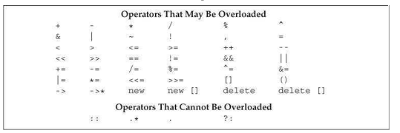
OBJECT ORIENTED PROGRAMMING WITH C++
Operator Overloading / Operator Functions
We can overload most, but not all, of the operators. Table below shows whether or not an operator may be overloaded.
We can overload only existing operators and cannot invent new operator symbols. For example, we cannot define operator** to provide exponentiation.

Slide 16
OBJECT ORIENTED PROGRAMMING WITH C++
Operator Overloading / Operator Functions
Programming examples for overloading
Binary Operator +
Relational operators <,==,!=
Unary Operator ++ (Post and Pre increment)
Insertion and Extraction Operators
Index Operator
Conversion Function

Slide 17
OBJECT ORIENTED PROGRAMMING WITH C++
Inheritance
Inheritance: Programming technique for defining a new class (known as a derived class) in terms of an existing class (known as the base class). The derived class inherits the members of the base class
We often find one object is a specialization / generalization of another
OOAD models this using ISA relationship
C++ models ISA relationship by Inheritance of classes

Slide 18
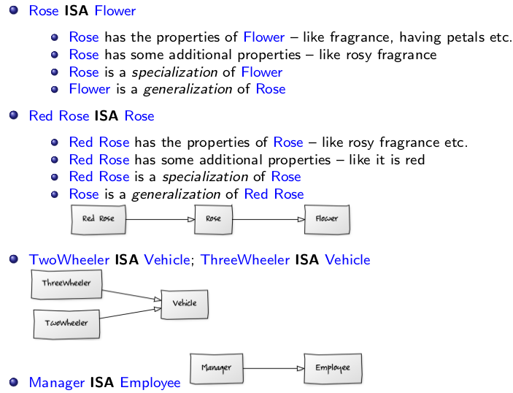
OBJECT ORIENTED PROGRAMMING WITH C++
IS A Relationship

Slide 19
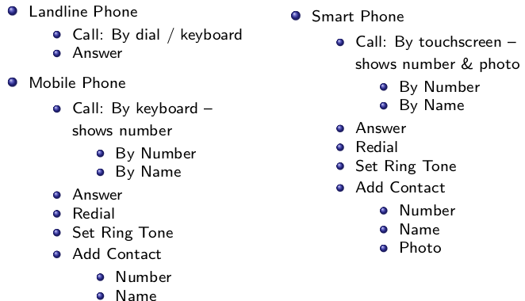
OBJECT ORIENTED PROGRAMMING WITH C++
IS A Relationship
There exists a substantial overlap between the functionality of the phones
• A mobile phone is more capable than a land line phone and can perform (almost) all its functions
• A smart phone is more capable than a mobile phone and can perform (almost) all its functions
• These phones belong to a Specialization / Generalization hierarchy

Slide 20
OBJECT ORIENTED PROGRAMMING WITH C++
IS A Relationship
Derived IS A Base
class Base;
class Derived: public Base
{
};
class derivation list

Slide 21
OBJECT ORIENTED PROGRAMMING WITH C++
Inheritance in C++: Semantics
Derived ISA Base
Data Members
Derived class inherits all data members of Base class
Derived class may add data members of its own
Member Functions
Derived class inherits all member functions of Base class
Derived class may override a member function of Base class by redefining it with the same signature
Derived class may overload a member function of Base class by redefining it with the same name; but different signature
Programming example

Slide 22
OBJECT ORIENTED PROGRAMMING WITH C++
Inheritance in C++: Semantics
Access Specification
Derived class cannot access private members of Base class
Derived class can access protected, and public members of Base class
Construction-Destruction
A constructor of the Derived class must first call a constructor of the Base class to construct the Base class instance of the Derived class
The destructor of the Derived class must call the destructor of the Base class to destruct the Base class instance of the Derived
Programming example

Slide 23
OBJECT ORIENTED PROGRAMMING WITH C++
Inheritance in C++: Data Members and Object Layout
Derived ISA Base
Data Members
Derived class inherits all data members of Base class
Derived class may add data members of its own
Object Layout
Derived class layout contains an instance of the Base class
Further, Derived class layout will have data members of its own
C++ does not guarantee the relative position of the Base class instance and Derived class members

Slide 24
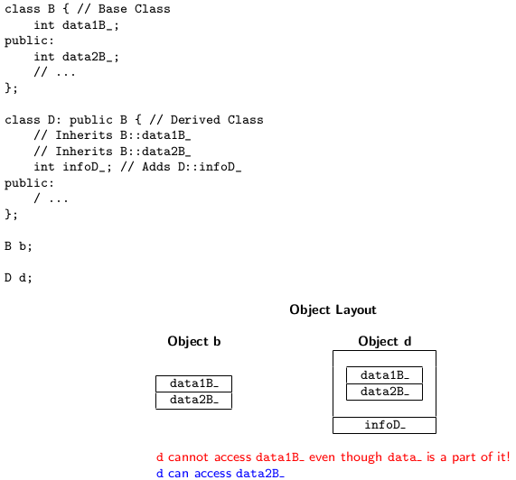
OBJECT ORIENTED PROGRAMMING WITH C++
Inheritance in C++: Data Members and Object Layout

Slide 25
OBJECT ORIENTED PROGRAMMING WITH C++
Inheritance in C++: Member Functions – Overrides and Overloads
Derived ISA Base
Member Functions
Derived class inherits all member functions of Base class
Derived class may override a member function of Base class by redefining it with the same signature
Derived class may overload a member function of Base class by redefining it with the same name; but different signature
Derived class may add new member functions
Programming example (for overload and override)
Static Member Functions
Derived class does not inherit the static member functions of Base class
Friend Functions
Derived class does not inherit the friend functions of Base

Slide 26
OBJECT ORIENTED PROGRAMMING WITH C++
Inheritance in C++: Constructors and Destructors
Derived ISA Base
Constructor-Destructor
Derived class inherits the Constructors and Destructor of Base class (But with a different semantics)
Derived class cannot override or overload a Constructor or the Destructor of Base class
Construction-Destruction
A constructor of the Derived class must first call a constructor of the Base class to construct the Base class instance of the Derived class
The destructor of the Derived class must call the destructor of the Base class to destruct the Base class instance of the Derived class
Programming example

Slide 27
OBJECT ORIENTED PROGRAMMING WITH C++
Access Specification
Derived Is A Base
Access Specification
Derived class cannot access private members of Base class
Derived class can access public members of Base class
protected Access Specification
A new protected access specification is introduced for Base class
Derived class can access protected members of Base class
No other class or global function can access protected members of Base class
Programming example

Slide 28
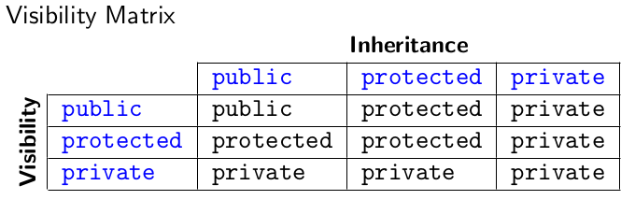
OBJECT ORIENTED PROGRAMMING WITH C++
Visibility across Access and Inheritance

Slide 29
OBJECT ORIENTED PROGRAMMING WITH C++
Copy Constructor and Assignment Operator
When defining a derived class, you need to be careful about copy constructors and operator=
The initialization phase of a derived-class constructor initializes the base-class part(s) of a derived object as well as initializes its own members. As a result, the copy and move constructors for a derived class must copy/move the members of its base part as well as the members in the derived
Similarly, a derived-class assignment operator must assign the members in the base part of the derived object. i.e., When a derived class defines a copy or move operation, that operation is responsible for copying or moving the entire object, including base-class members

Slide 30
OBJECT ORIENTED PROGRAMMING WITH C++
Copy Constructor and Assignment Operator
If your derived class does not have any special data (pointers, usually) that require a non default copy constructor or operator= , you don’t need to have one, regardless of whether or not the base class has one.
If your derived class omits the copy constructor or operator= , a default copy constructor or operator= will be provided for the data members specified in the derived class and the base class copy constructor or operator= will be used for the data members specified in the base class
On the other hand, if you do specify a copy constructor in the derived class, you need to explicitly chain to the parent copy constructor, as shown in the code in next slide. If you do not do this, the default constructor (not the copy constructor!) will be used for the parent portion of the object

Slide 31
OBJECT ORIENTED PROGRAMMING WITH C++
Defining a derived copy constructor
class Base
{
public:
Base(); //Base Class ctor prototype
Base(const Base& b); //Base class copy ctor prototype
};
class Derived : public Base
{
public:
Derived(); //Derived Class ctor prototype
Derived(const Derived& d); //Derived class copy ctor prototype
};
Derived::Derived(const Derived& d) : Base(d) //Copy the base members
/*Initializers for members of Derived*/ {/*.....*/}

Slide 32
OBJECT ORIENTED PROGRAMMING WITH C++
Defining a derived copy constructor
// probably incorrect definition of the D copy constructor
// base-class part is default initialized, not copied
D(const D& d) /* member initializers, but no base-class initializer */
{ /* ... */ }

Slide 33
OBJECT ORIENTED PROGRAMMING WITH C++
Defining a derived assigment operator
Derived& Derived::operator=(const Derived& rhs)
{
if (&rhs == this) //handle self assignment
{
return *this;
}
Base::operator=(rhs); // Calls parent's operator=
// Do necessary assignments for derived class
return *this;
}

Slide 34
THANK YOU
Kusuma K V
Department of Computer Science & Engineering
kusumakv@pes.edu

